Slide 1
Chapter 2 Probability
Dependent/ Independent Probability

Slide 2

Conditional Probability

Slide 3
Mutually Exclusive
Not simultaneous occurrence
Dependent
(Conditional)
Not Mutually Exclusive
simultaneous occurrence
Independent

Slide 4
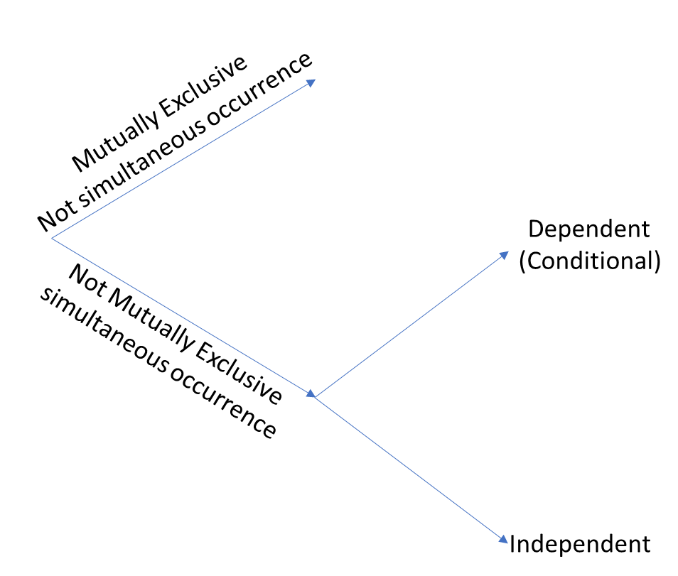

Slide 5


IF event A and B is INDEPENDENT, than
$$P\left(A∩B\right)=P\left(A\right)P(B)$$
IF event A and B is DEPENDENT, than

Slide 6
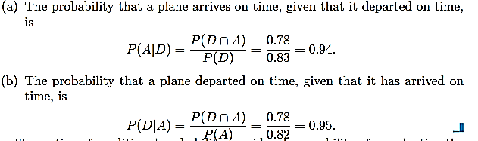

Slide 7
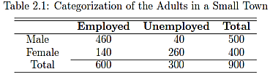



Slide 8
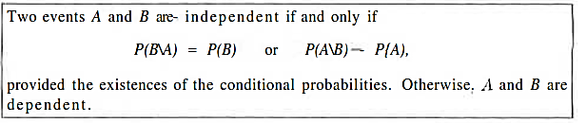
Independent Event

Slide 10


Slide 11



Slide 12
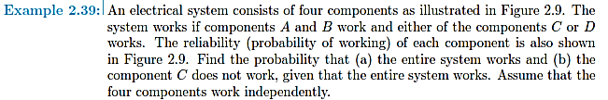
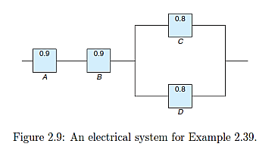

Slide 13
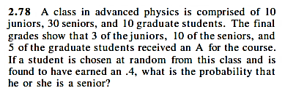

Slide 14
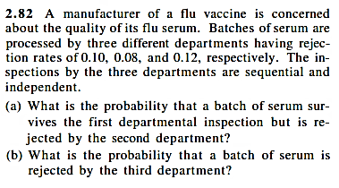
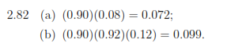

Slide 15
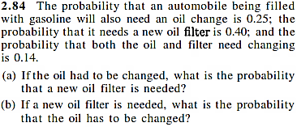
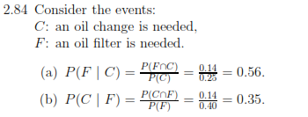

Slide 16


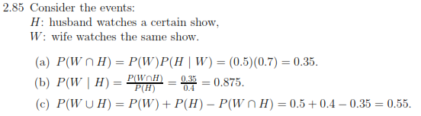

Slide 17



Slide 18
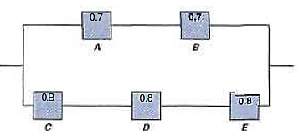
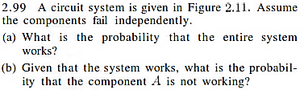


Slide 19
Ex 2.77-2.88
Ex 2.2.98-2.100

Slide 20
Bayes’ Rule
E
E’
E ∩ A
E’ ∩ A
A

Slide 22
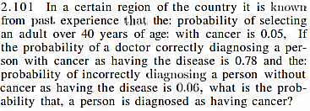


Slide 23
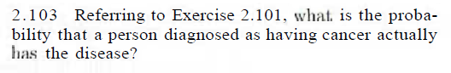

Slide 24
EX 2.101 - 2.108

